Slide 1
Smart garage door opener
Stacia Whelan
SEIS 744 – Internet of Things Final Project

Slide 2
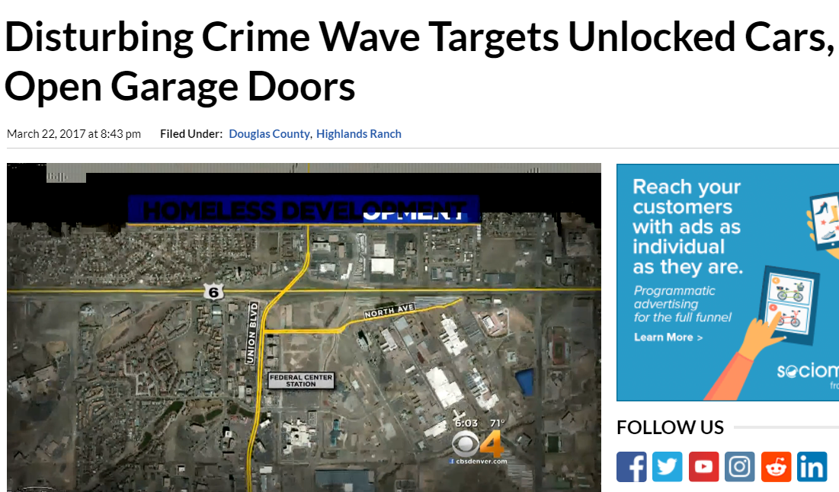

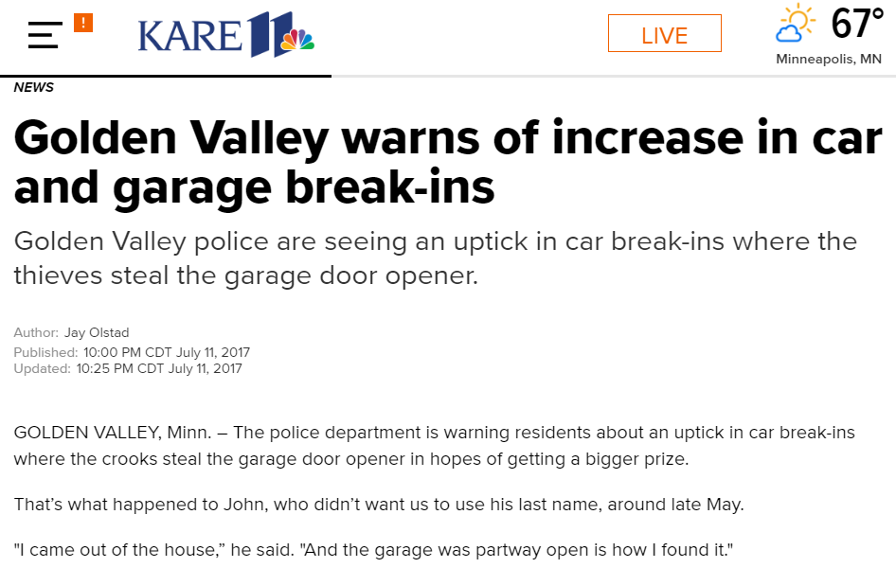

Slide 3

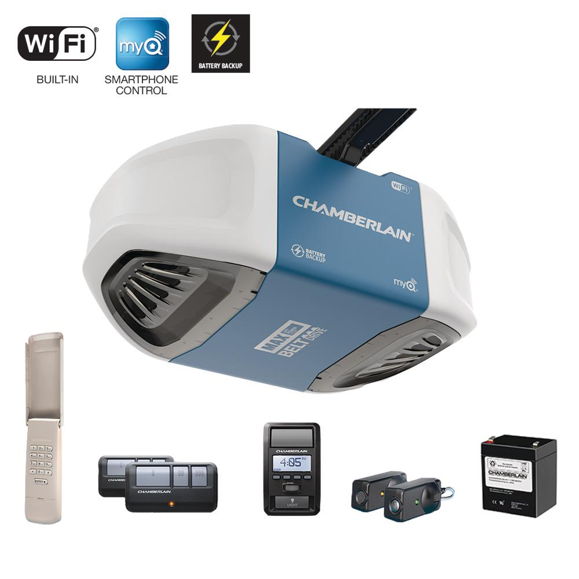
In the market
Best Buy
2 product sold
Chamberlain MyQ, Vivint
ASP: $80
Home Depot
~20 products sold
Chamberlain, Genie, Asante
ASP: $200

Slide 4
Photon garage door opener
Using Do Button and IFTTT Applet

Slide 5
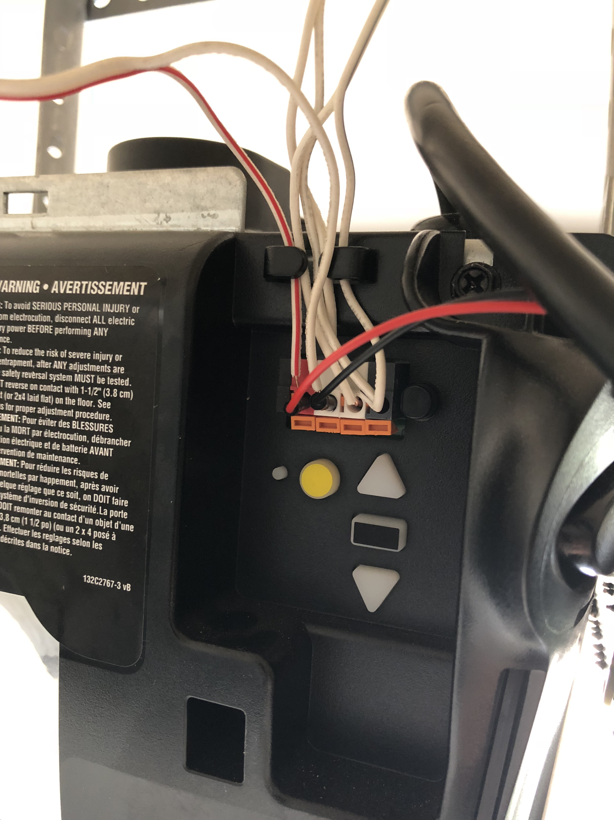
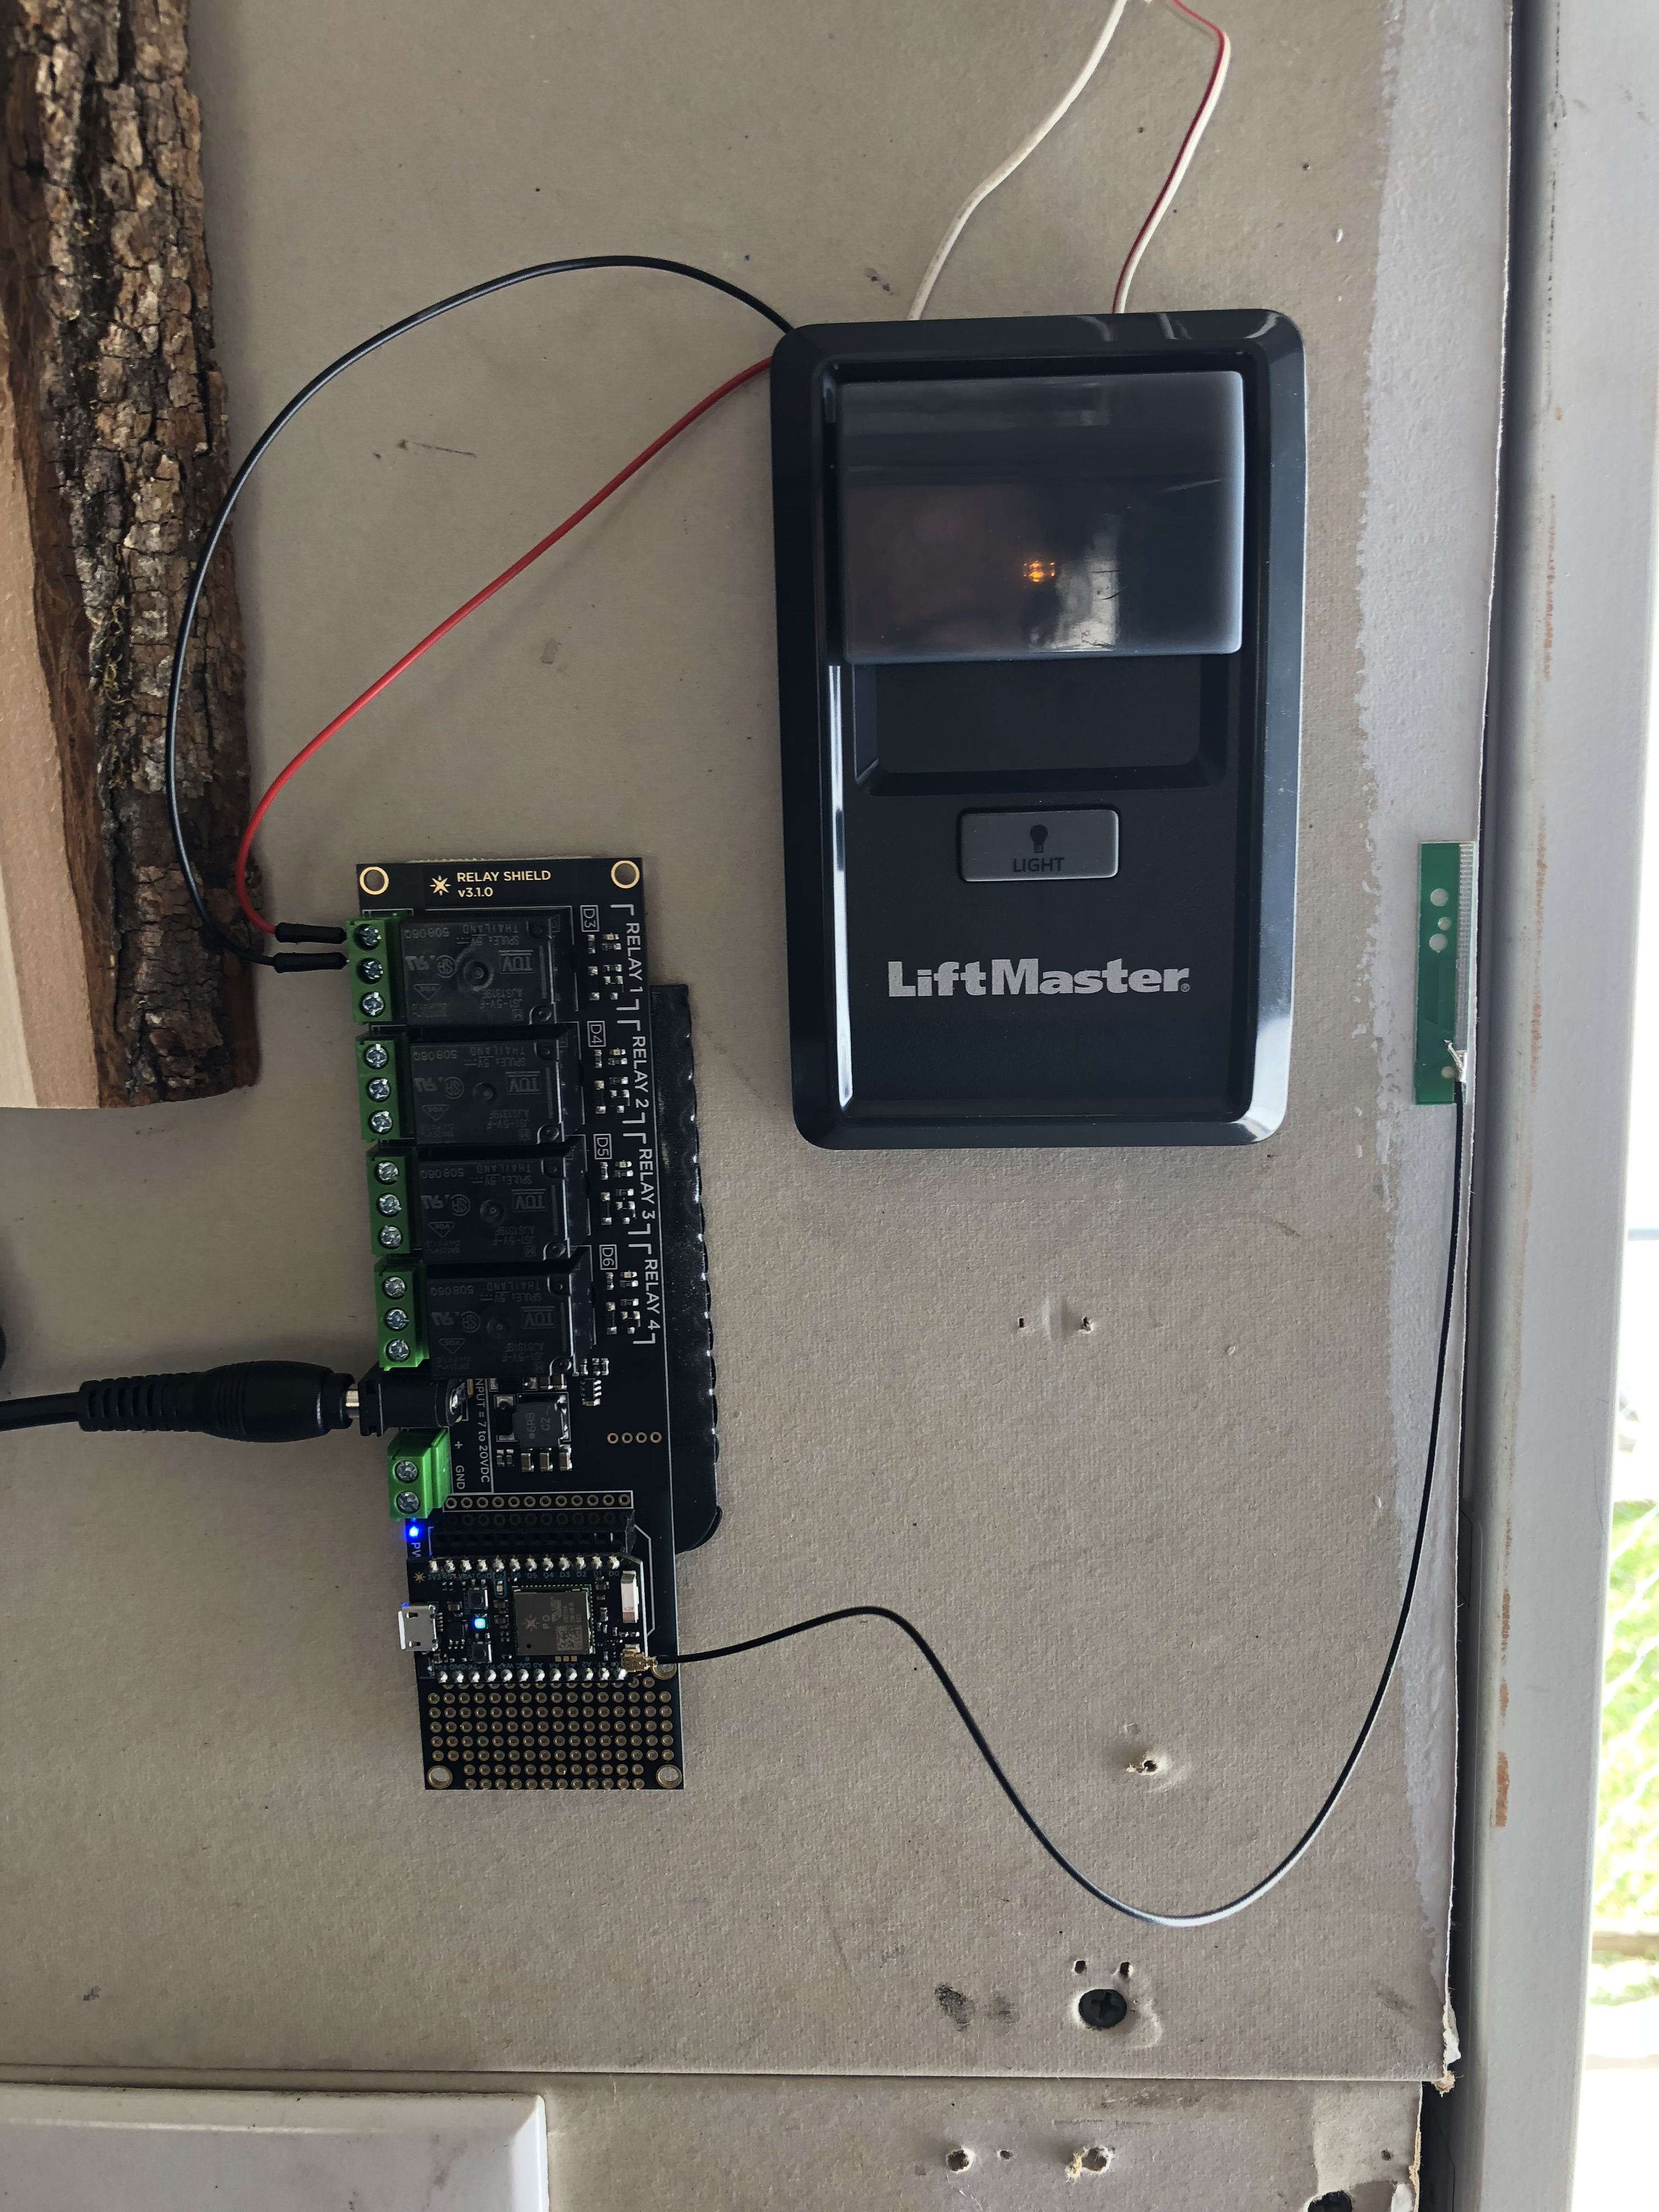
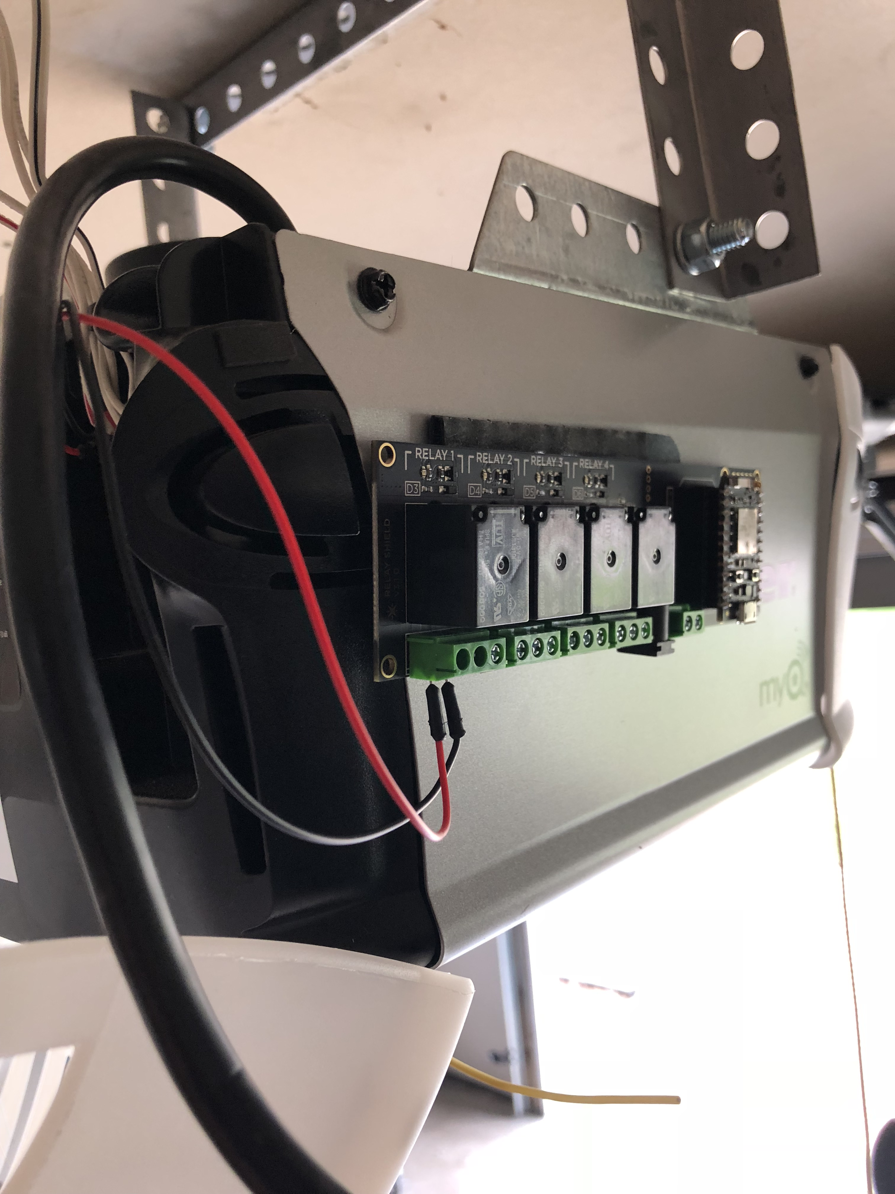
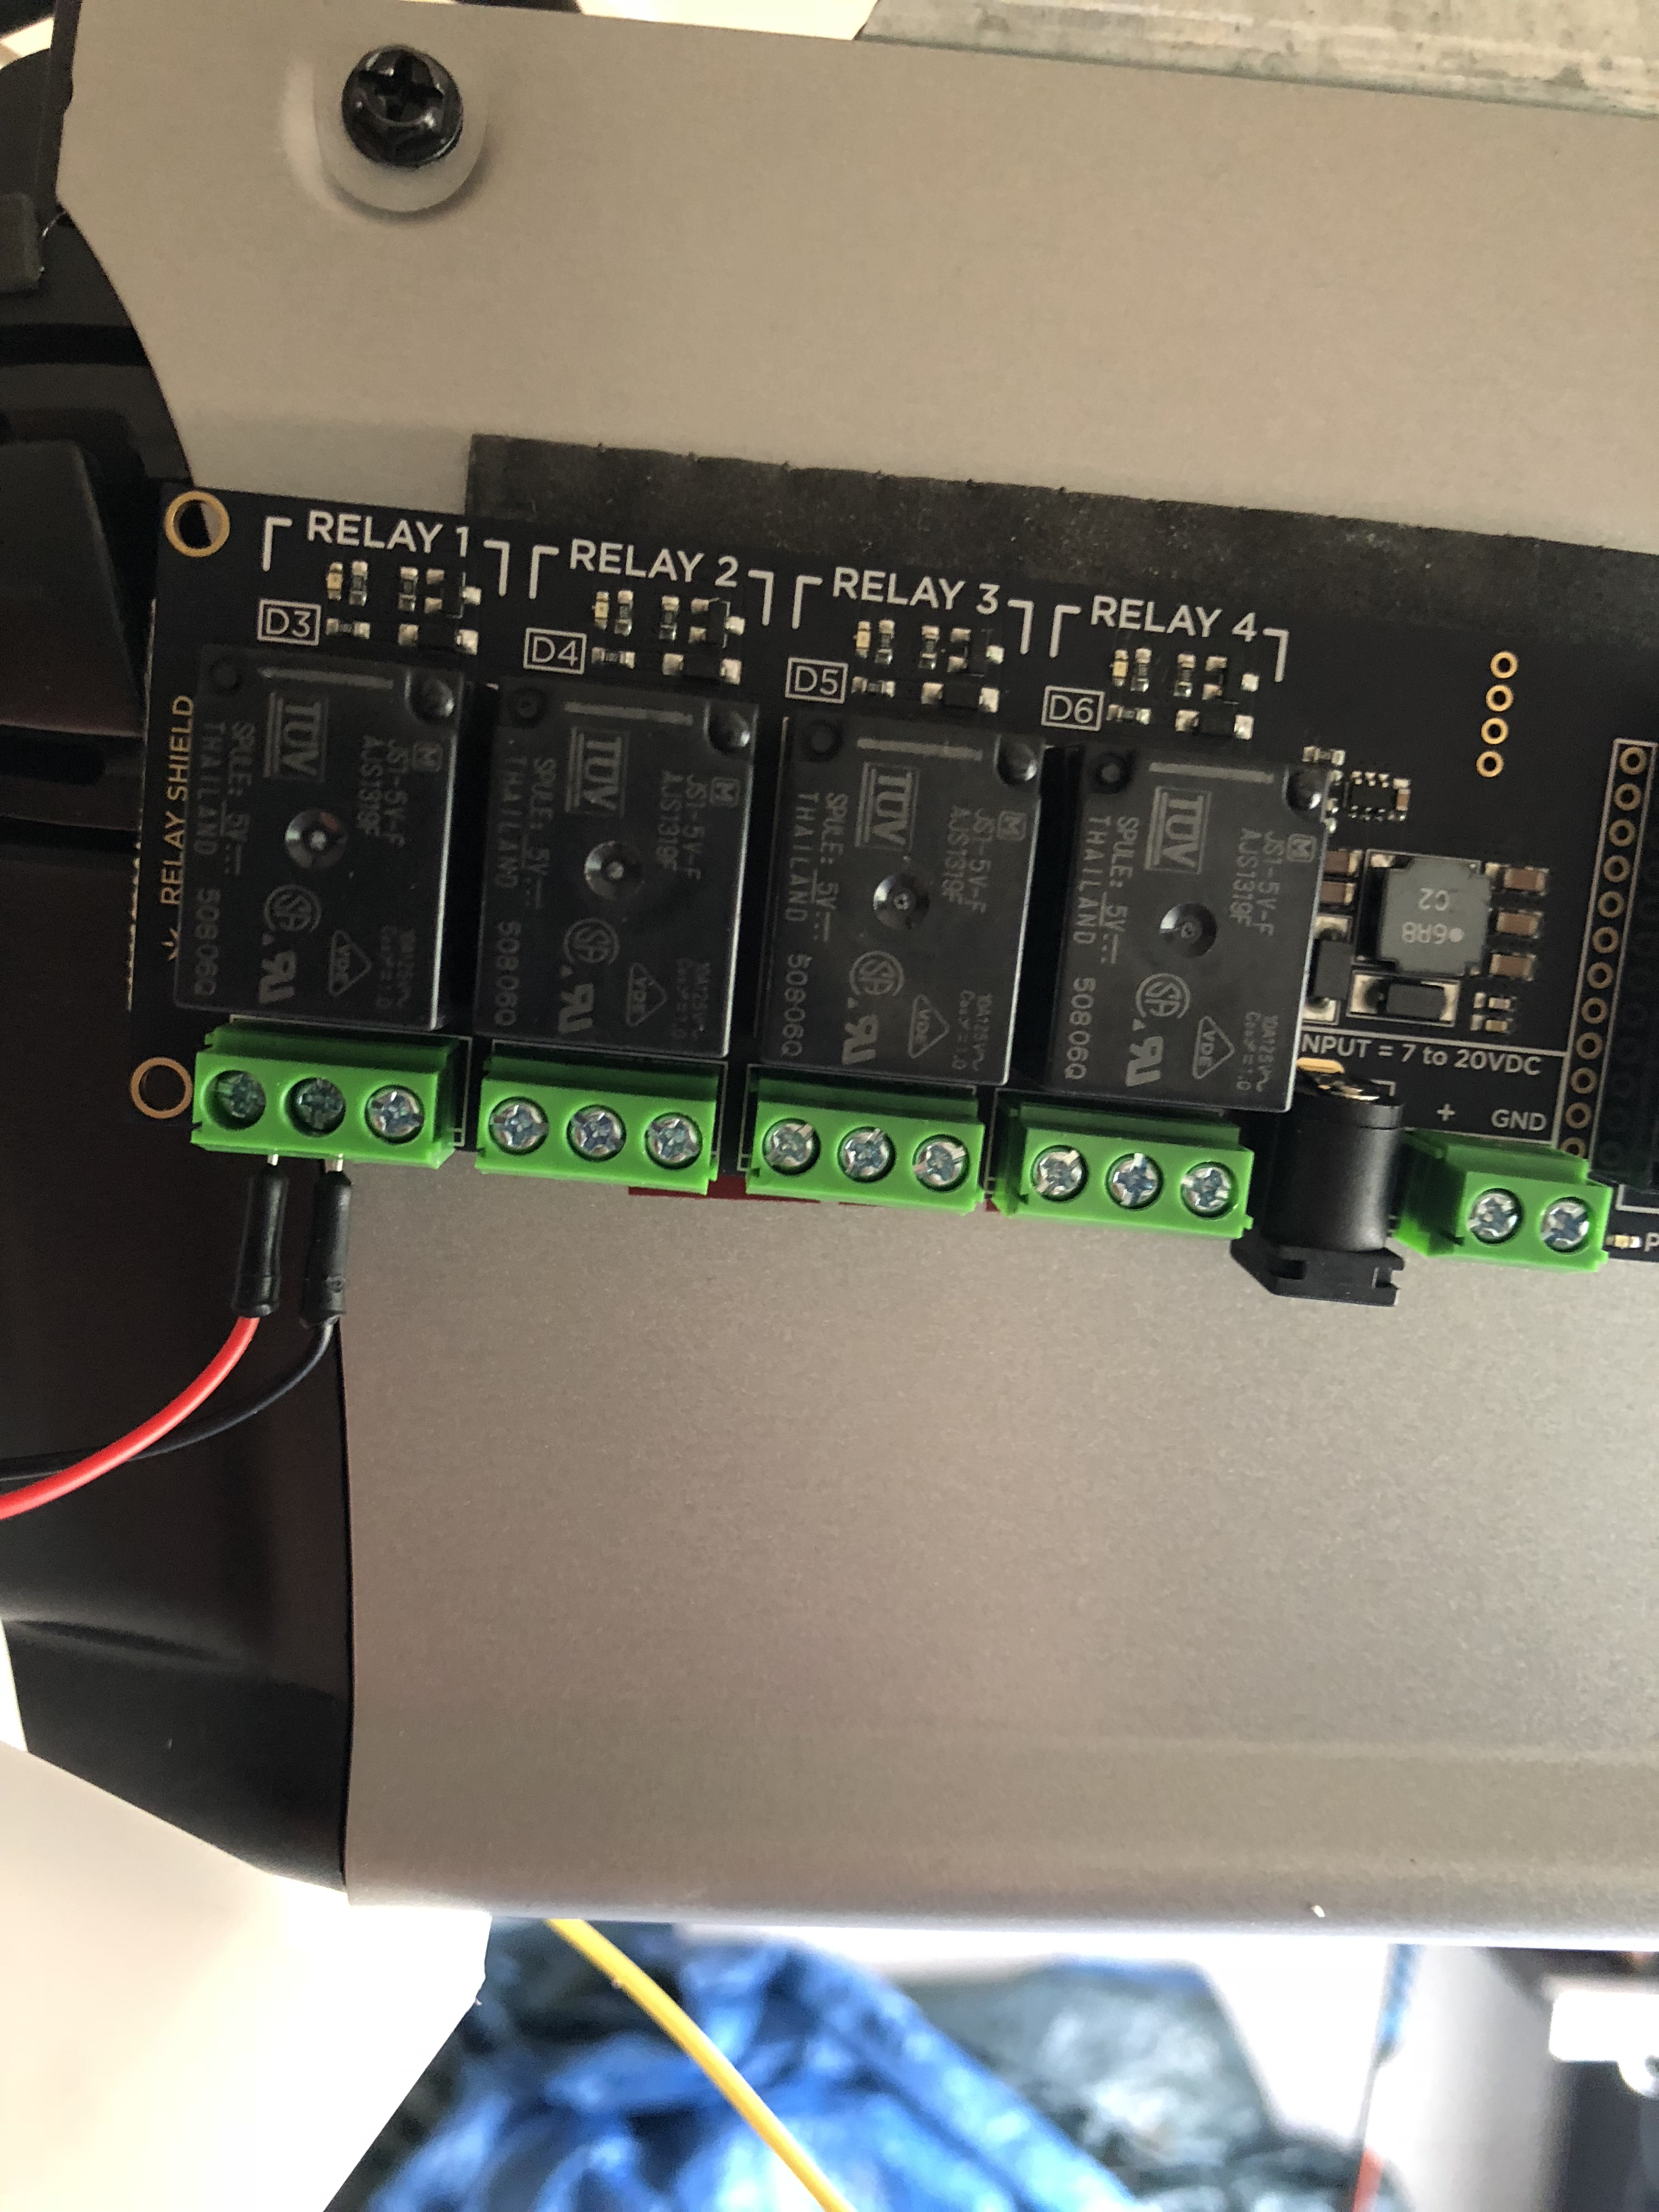
Things used in project
Particle Photon
Relay Shield
Power Supply
IFTTT Applet
Additional:
Antenna

Slide 6
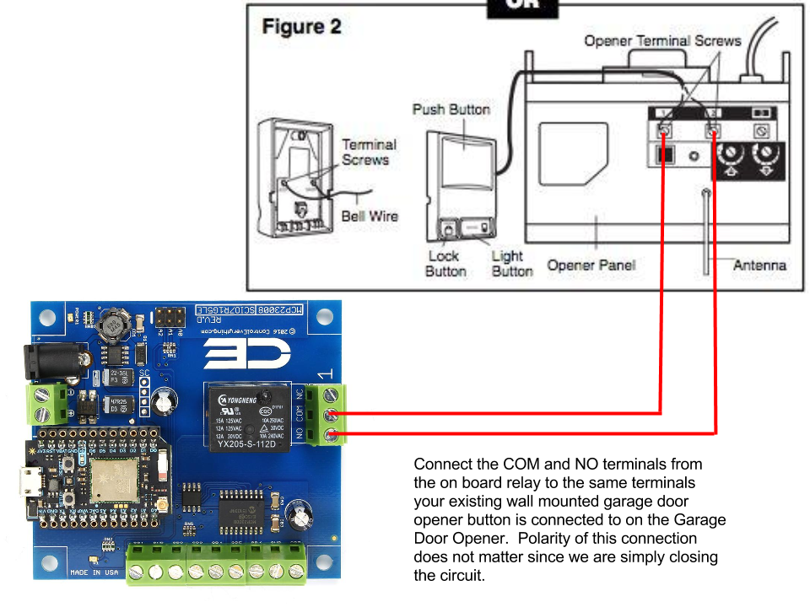
General Wiring

Slide 7
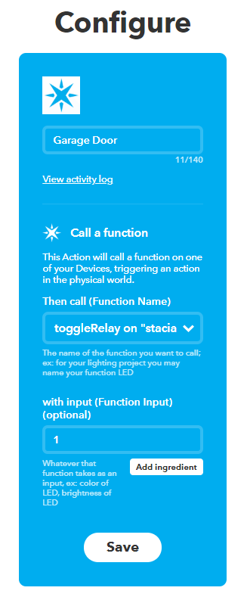
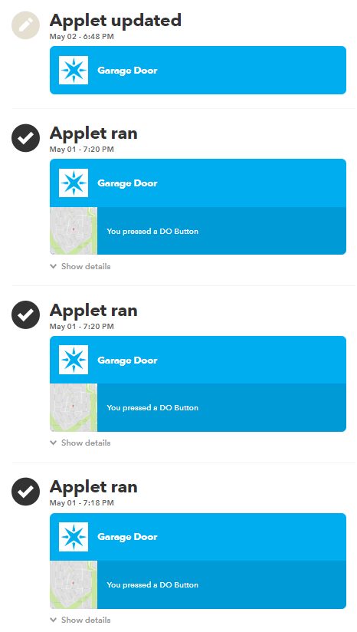
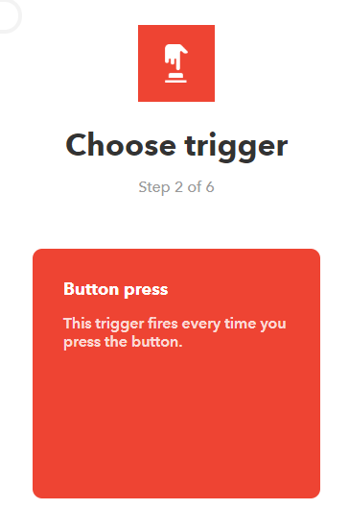

IFTTT applet setup
The button press mimics the actual press of a garage door opener button. Its called from the toggleRelay function in my Particle code

Slide 8
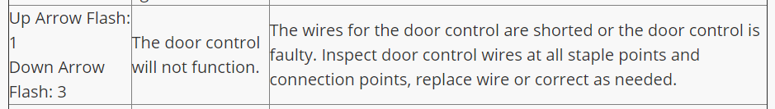
Product in use
After pushing the IFTTT button, I heard the relay fire twice (on/off), the garage door shutter, and then received this error code:
Short circuit: an electrical circuit of lower resistance than that of a normal circuit, typically resulting from the unintended contact of components and consequent accidental diversion of the current.
Too short of wires? Not wired correctly?

Slide 9
What’s next?

Slide 10
Next Iterations of Project
Get it working :D
Read garage door opener manual to understand circuitry
Modify code and Applet
Reed Switch to confirm whether the garage door is open or not
Also able to notify me when the garage door opens
Configure IFTTT Applet based on geolocation
Garage door opens when I am in proximity to my house, closes when I am out of range from my home

